Slide 1
Initial Setup and Training
Driver Monitoring System
University of St. Thomas
Khongmeng Kormoua

Slide 2
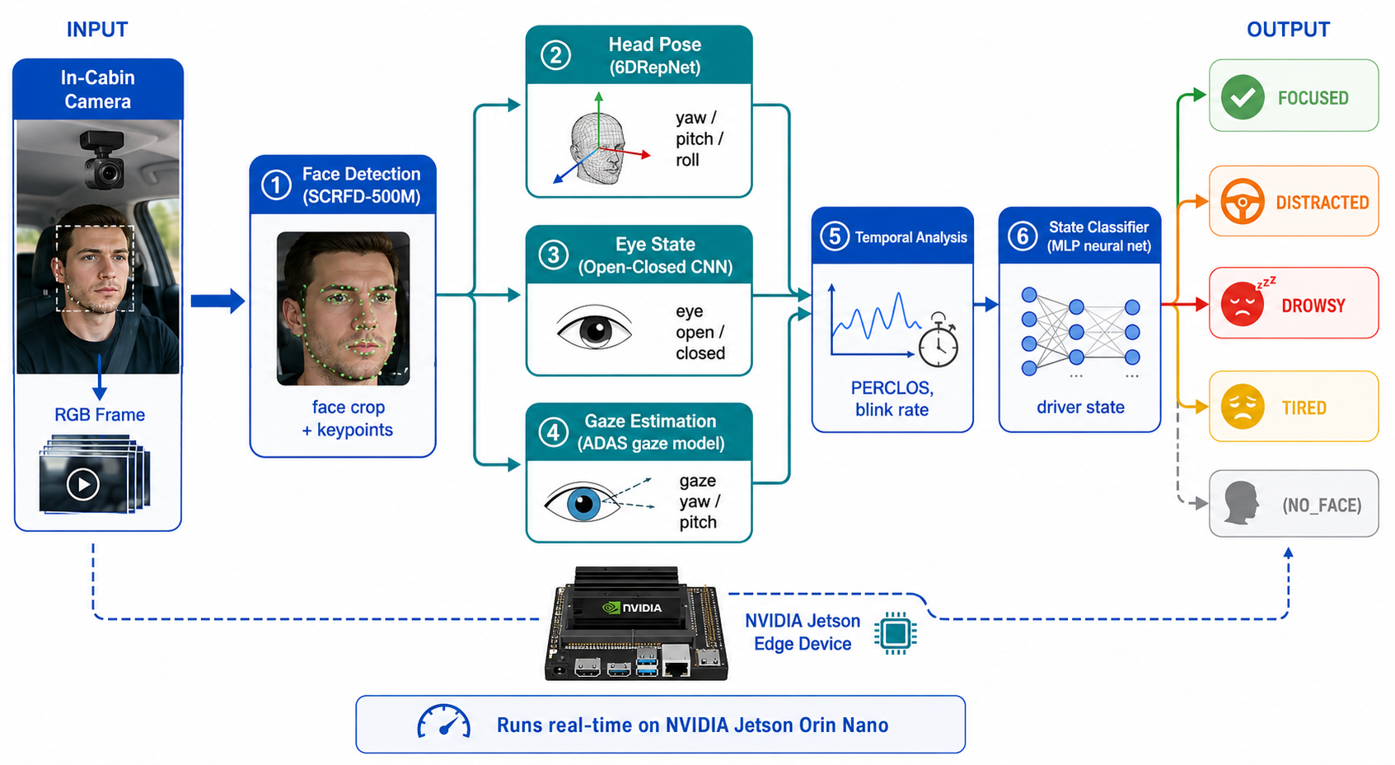
1
Pipeline Architecture
1. Double click to open recording

Slide 3
2
Dataset
Training: 10 drivers (169k frames, 3.2hrs)
Evaluate: 4 drivers (49k frames, 55mns)
States | Distribution [%]
Focus | 46
Distracted | 48
Drowsy | 2.7
Tired | 2.8

Slide 4
3
Training Setup
Parameters | Value
Epoch | 40
Optimizer | Adam
LR | 1e-3
Batch size | 1024
Loss function | Cross entropy
Preprocessing | Standard (mean, std)

Slide 5
4
Result
States | Precision | Recall | F1
Distracted | 0.72 | 0.55 | 0.63
Focus | 0.62 | 0.43 | 0.51
Drowsy | 0.1 | 0.57 | .017
Tired | 0.05 | 0.42 | 0.09

Slide 6
5
Dataset – Binary Classification
Training: 10 drivers (169k frames, 3.2hrs)
Evaluate: 4 drivers (49k frames, 55mns)
States | Distribution [%]
Attentive | 46
Inattentive | 54

Slide 7
6
Result
States | Precision | Recall | F1
Attentive | 0.55 | 0.677 | 0.607
Inattentive | 0.701 | 0.578 | 0.633

Slide 8
6
Result
States | Precision | Recall | F1
Attentive | 0.55 | 0.677 | 0.607
Inattentive | 0.701 | 0.578 | 0.633

Slide 9
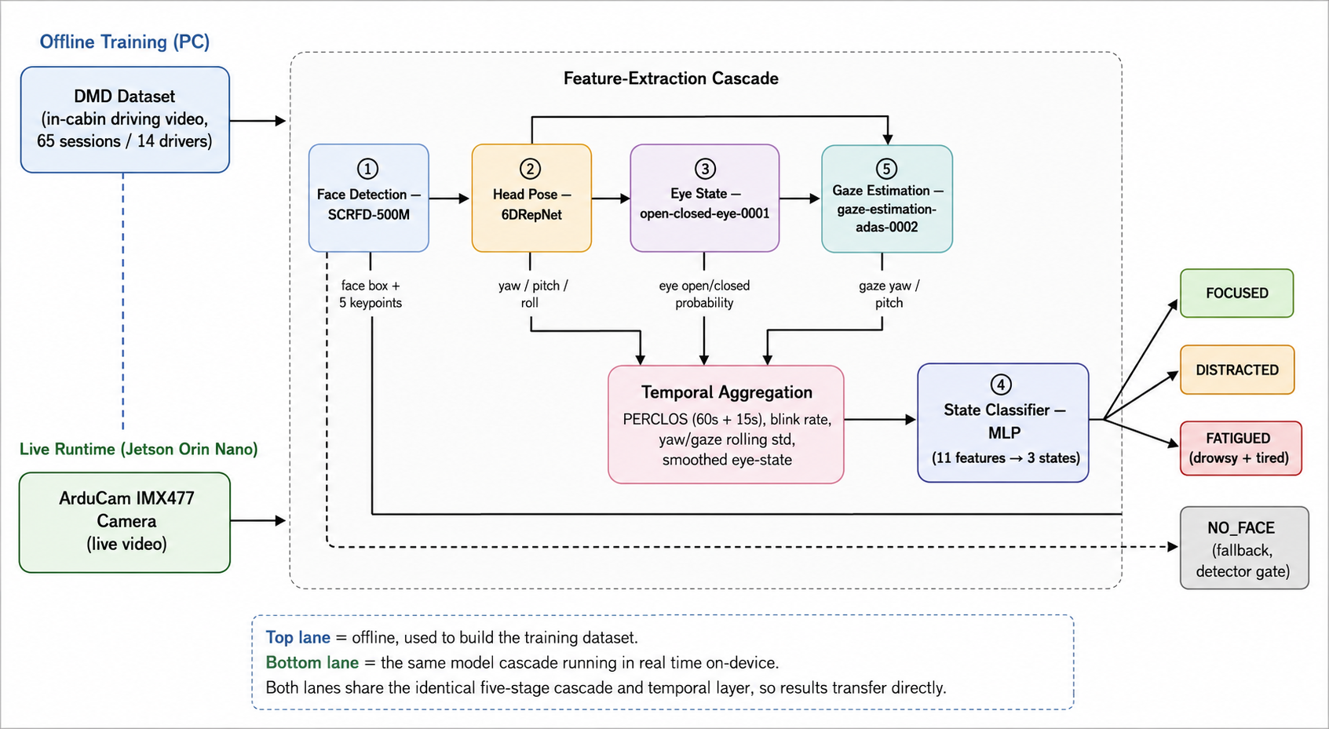
6
PIPELINE V2: Add more temporal features aggregation
Loss focal
Weight power 0.3
Evaluate with smooth window (30s)

Slide 10
6
Result
States | Precision | Recall | F1
Baseline (4 states) | 0.55 | 0.677 | 0.607
Baseline (2 states) | 0.701 | 0.578 | 0.633
V2 (3 states) | 0.588 | 0.618 | 0.599
States | Precision | Recall | F1
Distracted | 0.728 | 0.625 | 0.672
Focus | 0.589 | 0.676 | 0.63
Fatique | 0.446 | 0.553 | 0.494

Slide 11
6
3-states: undersample focus and distracted data.
States | Precision | Recall | F1
Focus | 0.648 | 0.775 | 0.706
Distracted | 0.808 | 0.669 | 0.732
Fatiqued | 0.568 | 0.685 | 0.621
Macro-F1 |  |  | 0.686

Slide 12
6
3-states: all data
States | Precision | Recall | F1
Focus | 0.687 | 0.746 | 0.716
Distracted | 0.786 | 0.812 | 0.799
Fatiqued | 0.871 | 0.821 | 0.845
Macro-F1 |  |  | 0.790

Slide 13
6
3-states: gated fatiqued
States | Precision | Recall | F1
Focus | 0.811 | 0.814 | 0.813
Distracted | 0.870 | 0.861 | 0.865
Fatiqued | 0.687 | 0.746 | 0.716
Macro-F1 |  |  | 0.798

Slide 14
6
3-states: esemble two model
States | Precision | Recall | F1
Focus | 0.828 | 0.827 | 0.827
Distracted | 0.881 | 0.864 | 0.872
Fatiqued | 0.656 | 0.821 | 0.729
Macro-F1 |  |  | 0.810

Slide 15
6
Result
Experiment | FOCUSED (P/R/F1) |  |  | DISTRACTED (P/R/F1) |  |  | FATIGUED (P/R/F1) |  |  | macro-F1 | Accuracy
SVM (RBF) | 0.593 | 0.551 | 0.571 | 0.725 | 0.584 | 0.647 | 0.193 | 0.785 | 0.310 | 0.509 | 0.579
CNN+GRU frozen, focal | 0.697 | 0.683 | 0.690 | 0.747 | 0.811 | 0.777 | 0.880 | 0.130 | 0.226 | 0.565 | 0.726
CNN+GRU frozen, default | 0.705 | 0.665 | 0.684 | 0.749 | 0.786 | 0.767 | 0.279 | 0.272 | 0.275 | 0.576 | 0.712
MLP (default weighting) | 0.592 | 0.710 | 0.646 | 0.767 | 0.559 | 0.646 | 0.337 | 0.802 | 0.475 | 0.589 | 0.633
Random Forest | 0.566 | 0.774 | 0.654 | 0.770 | 0.559 | 0.648 | 0.569 | 0.439 | 0.495 | 0.599 | 0.645
GBT | 0.580 | 0.721 | 0.642 | 0.754 | 0.577 | 0.654 | 0.424 | 0.646 | 0.512 | 0.603 | 0.641
CNN+GRU fine-tuned | 0.672 | 0.946 | 0.786 | 0.944 | 0.667 | 0.781 | 0.803 | 0.380 | 0.516 | 0.695 | 0.775
R3D-18 (3D-CNN) | 0.690 | 0.923 | 0.789 | 0.929 | 0.696 | 0.796 | 0.692 | 0.458 | 0.551 | 0.712 | 0.784
TCN | 0.648 | 0.871 | 0.743 | 0.884 | 0.619 | 0.728 | 0.603 | 0.801 | 0.688 | 0.720 | 0.734

Slide 16
6
Parameters & Hyperparameters
Experiment | Architecture | Window (len/stride) | Batch | Epochs (best) | LR | Backbone LR | Loss | Weight-power
SVM | RBF kernel, C=10.0, gamma=scale | – (30k subsample) | – | – | – | – | – | 1.0
MLP (default) | 2-layer MLP, 64→32 | per-frame | 1024 | 40 (last) | 1e-3 | – | CE | 1.0
Random Forest | 300 trees | per-frame | – | – | – | – | – | 1.0
GBT | HistGradientBoosting, max_iter=300 | per-frame | – | – | – | – | – | 1.0
TCN | 6 dilated-causal blocks, kernel=3, hidden=64 | 600 / 300 | 16 | 40 (25) | 1e-3 | – | CE | 1.0
CNN+GRU (frozen, default) | ResNet18 (frozen) → proj128 → GRU(64,2) | 600 / 300 | 16 | 40 (1) | 1e-3 | – | CE | 1.0
CNN+GRU (frozen, focal) | Same as above, frozen | 600 / 300 | 16 | 40 (1) | 1e-3 | – | Focal (γ=2.0) | 0.3
CNN+GRU (fine-tuned) | ResNet18 (layer4 unfrozen, 8.5M/11.3M) → proj128 → GRU(64,2) | 256 / 256 | 2 | 15 (9) | 1e-3 | 1e-4 | CE | 1.0
R3D-18 | R3D-18 (layer4 unfrozen, 24.9M/33.2M), clip classifier | 16 / 16 (clip) | 8 | 10 (1) | 1e-3 | 1e-4 | CE | 1.0

Slide 17
Vision Transformer
CNN, 3D-CNN,
Setup learning rate scheduler
Organize Github
Upload AI and Vision AI content to drive for Dr. Min

